Slide 1
Funding provided by Illinois R3 Grant
Youth Grief Support Groups
Training Program
How to Create & Facilitate
Support Groups

Slide 2
Purpose of Grief Support Group Training Program
Objective:
Provide facilitators with knowledge on the needs and tasks of mourning which make up the framework for many grief support groups.
Objective:
Facilitators will be able to address youth grief through use of structured activities and lessons provided in this program for both individual and group settings.

Slide 3
Benefits of Grief Support Groups
Provides a safe, non-judgmental space to share thoughts, emotions and struggles
Provides venue to deal with changes in identity, roles, relationships
Helps normalize the intense impact of grief
Learn inner and outer resources for coping
Protects against shame & isolation from a
culture that avoids mourning
Helps learn new ways of problem solving from peers
Learn about self-acceptance, self-care, self-compassion and resiliency
Supports other in search for meaning and purpose in life without their loved one

Slide 4
This training program is designed to provide knowledge and skills for lay people and therapists to facilitate grief support groups.
Please note:
The focus of the program is aimed at facilitation of support groups versus a therapeutic group.
Licensed professionals may use materials for therapeutic work.
Trainings
Curriculum
Resources
Grief Toolkit
Clinical Support

Slide 5
Virtual E-Learning Platform
Resources
Handouts
Websites
Book List
Updates will be sent out as more materials are added to the platform

Slide 6
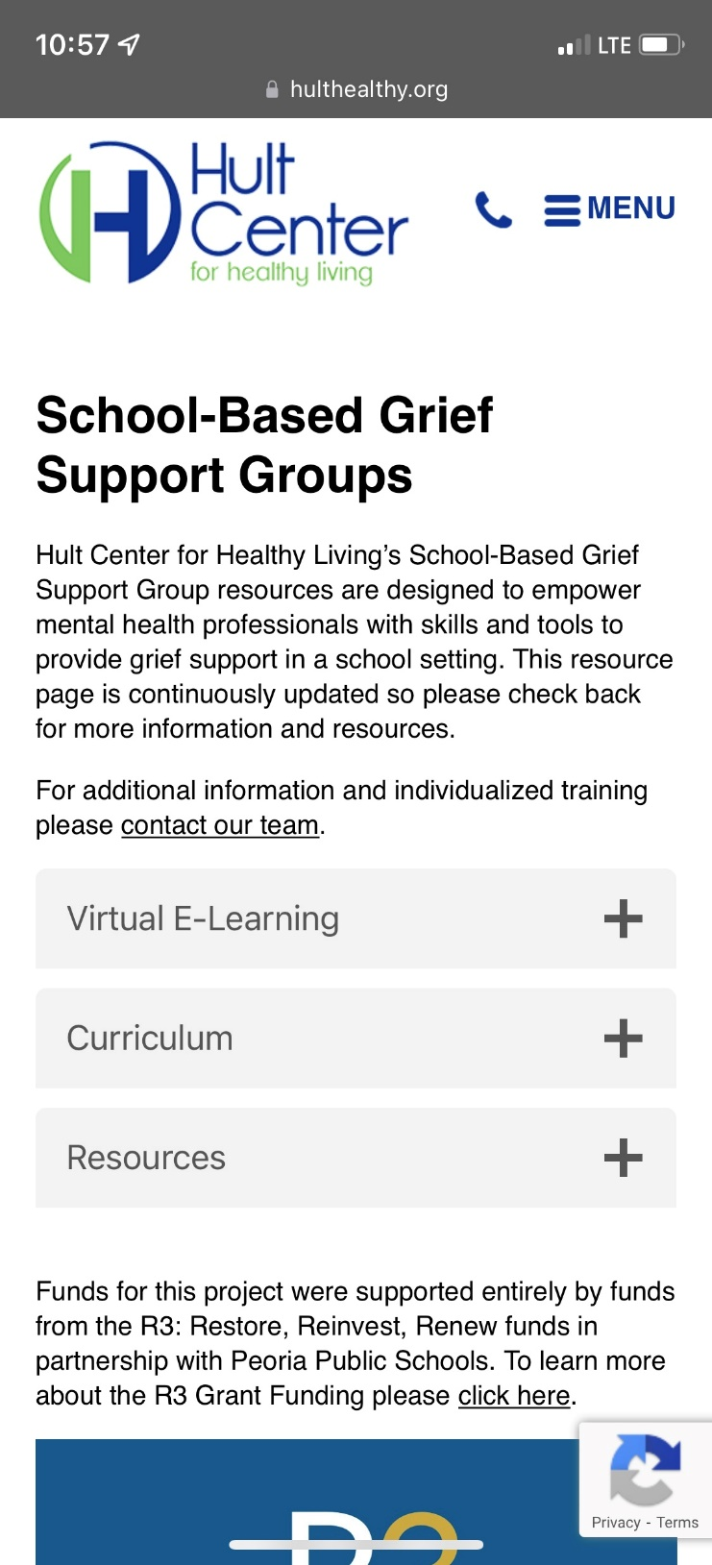
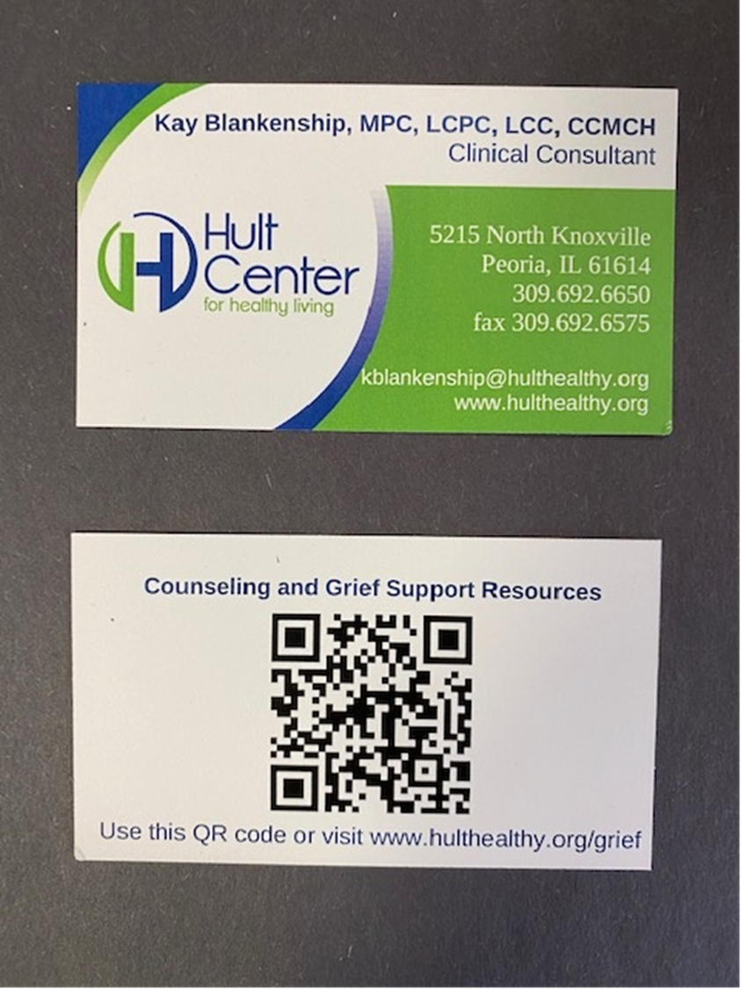
Trainings
Access through
QR Code
Hult’s Virtual E-Learning Platform

Slide 7
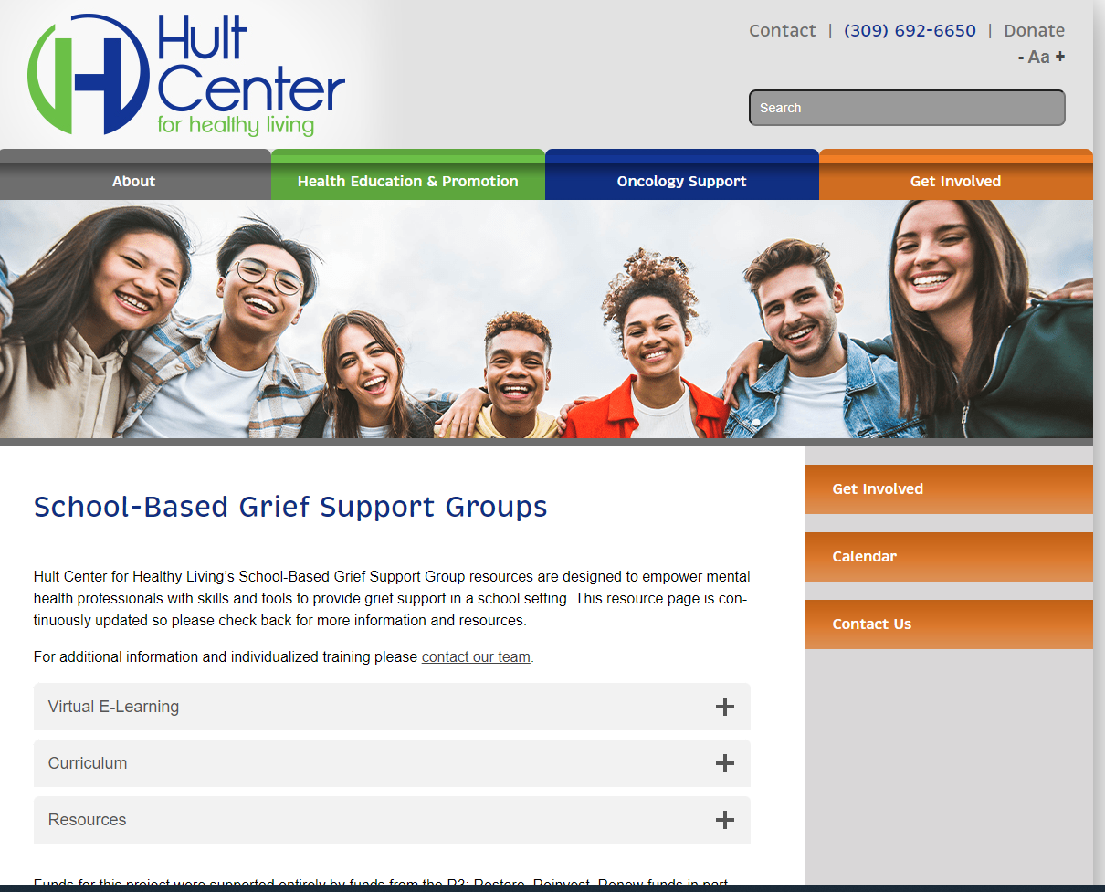
Trainings
Access through
www.hulthealthy.org/grief
Hult’s Virtual E-Learning Platform

Slide 8
Current
Trainings
How to Create and Facilitate a Group
Worden’s 4 Tasks of Mourning
Wolfelt’s 6 Needs of Mourning
5 Stages of Grief
Types of Grief
Grief & Mourning
Support Group’s 5 Developmental Stages, managing
group dynamics – personalities – red flags
Understanding Grief & Misconceptions
Special topics – student death
- suicide best practices
Other suggestions?
Possible
Future
Trainings
Will be added to the learning platform in the 2023 grant cycle

Slide 9
6 Week
Grief Support Group Curriculum
Alan Wolfelt, PhD
6 Needs of Mourning

Slide 10
Need1
To accept the reality of the loss.
6
NEEDS
OF MOURNING
Need 2
Feel the pain of the loss.
Need 3
Convert the relationship with deceased from one of presence to one of memory.

Slide 11
Need 4
Develop a new self-identity.
6
NEEDS
OF MOURNING
Need 5
Search for meaning.
Need 6
Continue to receive support from others.

Slide 12
6 Week Curriculum
Lesson Plans
WEEK 1 – All about Me and My Person Who Died
Week 2 – Understanding the Concepts of Grief & Loss
Week 3 – Feelings & Behaviors Related to Loss
Week 4 – Healthy Coping Skills
Week 5 – Honoring my Loved One
Week 6 – Support Systems

Slide 13
Allowing & encouraging mourning through:
Sharing of Memories, both spontaneous and through specific group activities
Linking objects and photos
Visiting special places
Journal activities between groups
Expressing hopes for memories that “wish” could have been but never “were”
Need 3
Convert the relationship from one of presence to one of memory
Embracing past memories allows for hope and makes future open to new experiences and relationships
Keeping memories alive while accepting reality of the death

Slide 14
Benefits of Group Work:
Allows members to talk about and explore their identity changes with similar situations
May discover positive aspects of self growth
Examples: assertive, confidence, empowered even though they may still feel a continued sense of loss
Need 4
Developing
a
New
Self-Identity

Slide 15
Natural state of questioning Meaning of Life
Spiritual - Religious
Death creates feelings of : Lack of Control
Feeling Powerless
Need 5 Searching for Meaning
Benefits of Group Work:
Allows members a safe, nonjudgmental place to search
for meaning
to address the “Whys”
“Why did this happen?” “Why now?” “Why this way?”
With group support realization that humans can’t have complete control over themselves or this world

Slide 16
6th Need of MOURNING
Receiving Ongoing Support from Others

Slide 17
Need 6
Ongoing Support from Others
Importance of Receiving Support
Mourning process takes place over time – so should support
Society places value on ability to “carry on”
Support groups – demonstrate that help seeking behavior as a strength not a weakness
Support groups – way to receive support for a finite number of weeks, however, friendships and connections made may last longer

Slide 18
Menu of Lesson Plans for each week
Designed for a Six Week Program
To increase number of weeks
select additional lesson plan activities
For example:
You may wish increase Week 1 “getting to know you activities” to create rapport, ground rules, etc.
Online Resources Menu
Ice-Breakers start each group
Additional handouts

Slide 19
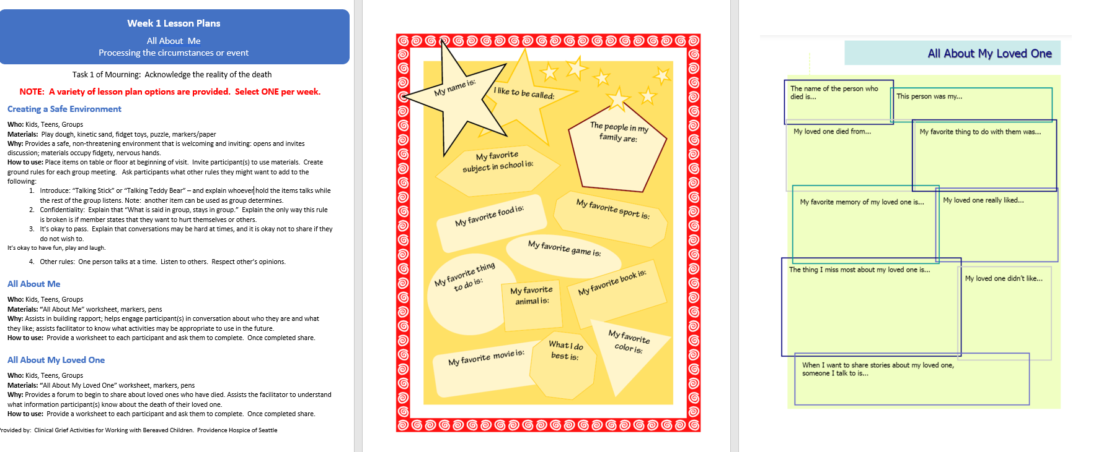
Example of Lesson Plans
“We live in a culture that teaches us to
move away from grief and NOT towards it.”

Slide 20
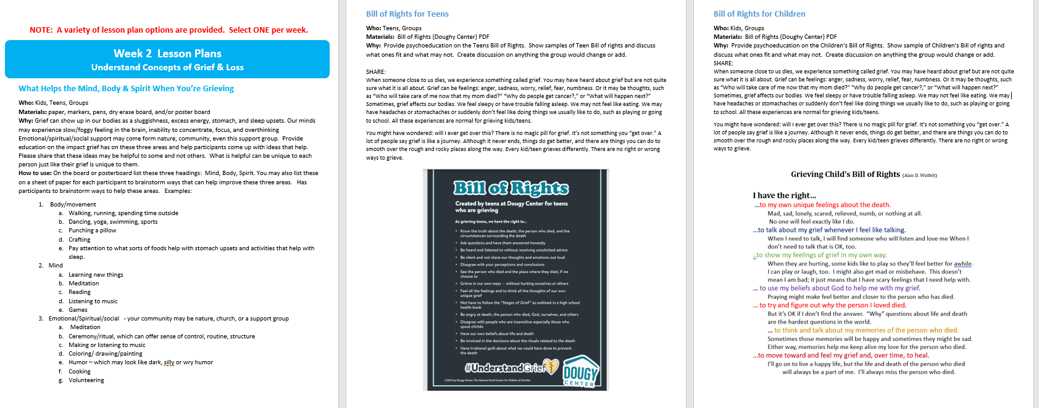
Example of Lesson Plans
“We live in a culture that teaches us to
move away from grief and NOT towards it.”

Slide 21
Online Resources
Hult Center’s Website
www.hulthealthy.org/grief
Sample Forms (word document format)
Referral Form
Group Rules Poster
Intake Questionnaire
Parent/Guardian letter – invitation for child to join group
Parent Update letter about group activities
Helpful with younger members
Engages parents/guardians in grief work

Slide 22
Considerations
for creating a group

Slide 23
Planning the Group
Open Group
Involves changing membership
Participants learn from a variety of people over time
Gives members flexibility
Allows for more flexible content and structure
Disadvantages
Challenge for facilitator to deal with unpredictable numbers
Challenge to create and/or develop sense of safety each week

Slide 24
Planning the Group
Closed Group
Participants make a commitment to attend pre-set number of week
Recommended after 2nd week to not admit new members
Trust builds over time with members
More defined structure – with set material and focus based on cohorts needs
Disadvantages
Participants can only join at a set time
Challenge to create and/or develop sense of safety each week

Slide 25
Considerations
In-school setting
Size of Group
Challenge if too large: No time for all participants to share
Challenge if too small: Makes it hard to run a group with less than 5 participants
How often does group meet?
weekly, every other week
Time of day to offer group?
rotates each class period (except for lunch)
Length of time of each group meeting
standard class period, 45 minutes
Where will group be held?
Privacy, same room, space for activities
Some trying to be helpful, may try to take the memories away saying things like:
“take down their pictures”
“stay busy”

Slide 26
Is group opened or closed?
What is your school referral process?
Who makes the referrals in your school?
Who screens youth to participate?
Counselors, social workers, teachers, administrators, support group facilitator?
Considerations
for in-school setting

Slide 27
Create a non-judgmental, inclusive safe space
Lead group; model compassion, openness, empathy, and respect
Listen and communicate clearly, be comfortable with silence, the expression of emotions, and conflict
Respond to conflict and problems; guide members towards constructive behaviors
Set appropriate boundaries
Assess for signs of complicated grief, impact of different types of losses on the grief process – example: traumatic grief
Know referral sources
Know when to refer someone for specialized support
Role of
Group
Facilitator

Slide 28
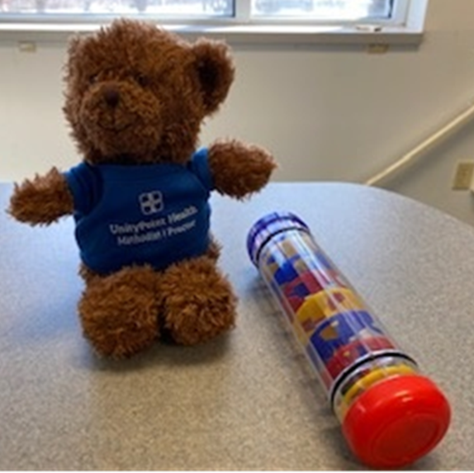
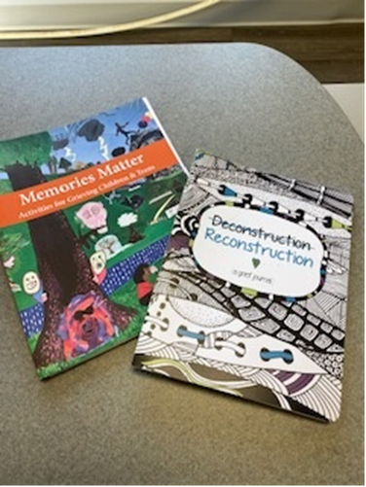
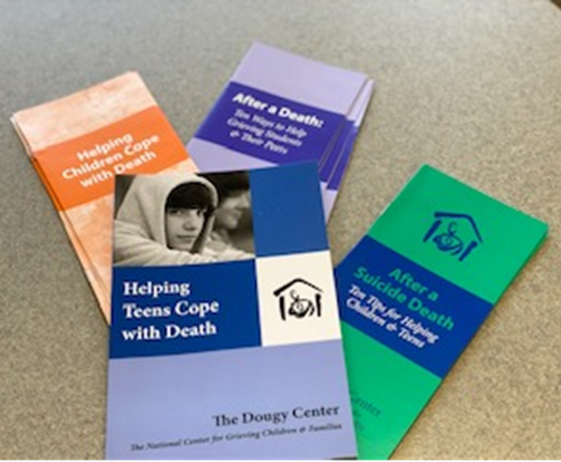
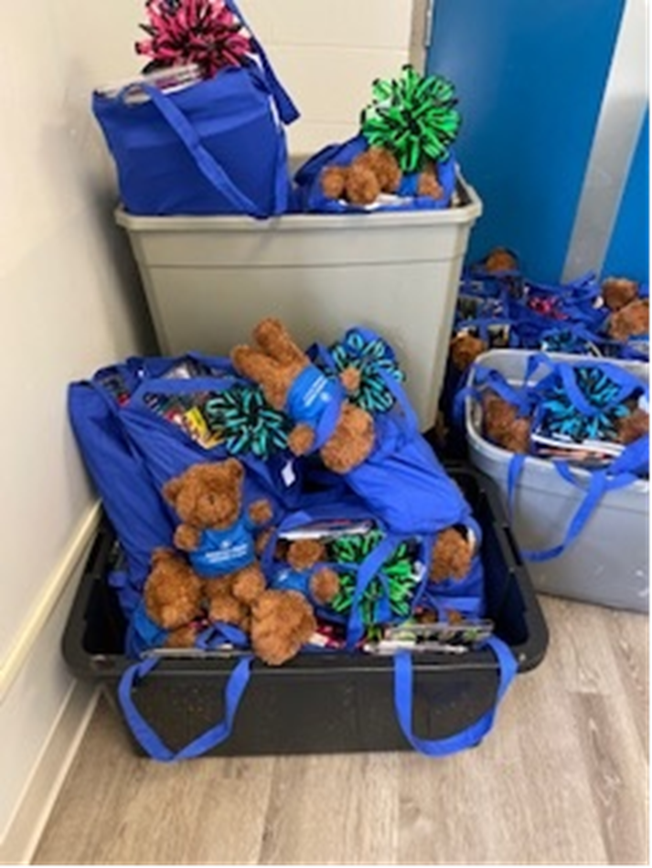
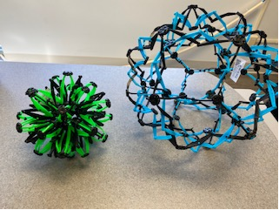
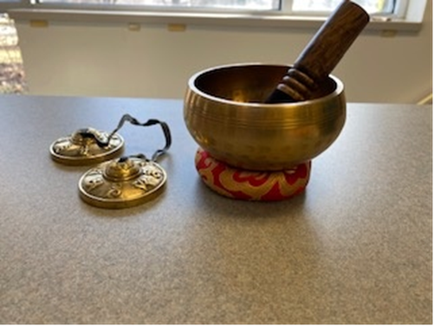
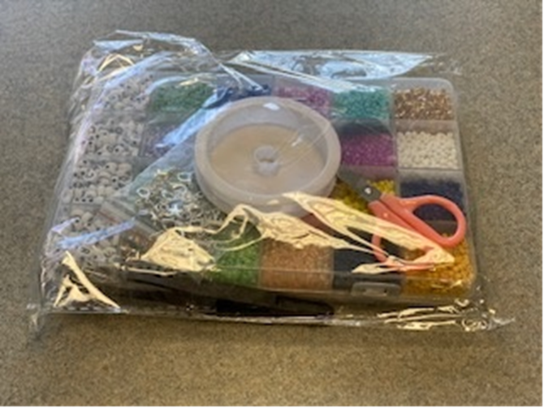
Grief Tool Items
.

Slide 29
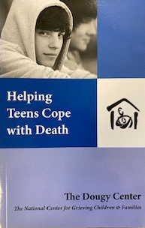
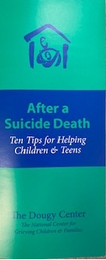
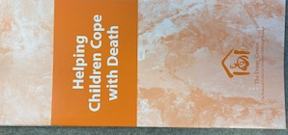
Grief Toolkit
Book
Pamphlets

Slide 30
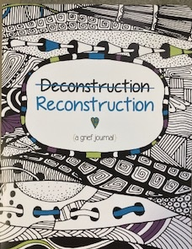
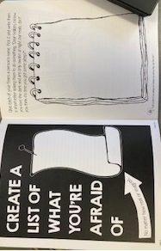
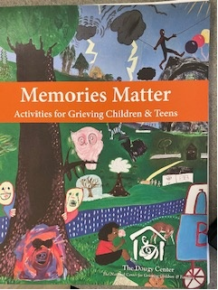
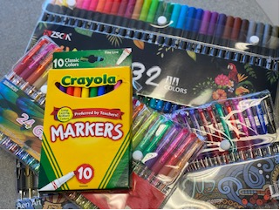
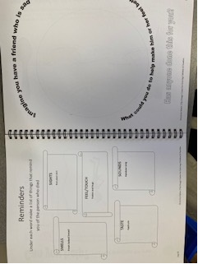
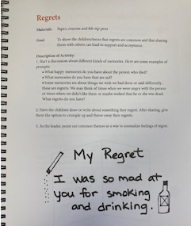
Grief Toolkit
Group Activies
Icebreakers
Journal Prompts

Slide 31
Grief Toolkit
“Talking” Stick/Bear
Breathing Items
Tibetan Singing Bowl
Chimes
Breathing Ball

Slide 32
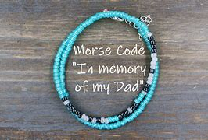
Grief Toolkit
Bead Sets
Memory Bracelets

Slide 33
Consultation
Call: Hult Center for Healthy Living
(309) 692-6650
Available to meet in-person, virtual, by phone
Answer Questions
Provide Feedback & Trouble Shoot

Slide 34
References
The Doughy Center – Child Bereavement. (2022). https://www.dougy.org
Prigerson & Maciejewski. (2018) Grief and acceptance as opposite side of the same coin: setting a research agenda to study peaceful acceptance of loss. The British Journal of Psychiatry.
The Therapy Centre. (2022). https://thetherapycentre.ie/william-wordens-four-tasks-of-grief
Kubler-Ross, Elisabeth. (1969). On Death and Dying
Kessler, David. (2019). Finding Meaning, The Sixth Stage of Grief.
OUR HOUSE Grief Support Center. (2022). www.OurHouse-Grief.org
O’Brien, Mauryeen. (2000). New Day Journal
Thompson K. ( 2012). Counsellors’ reflections on disenfranchised grief. New Zealand Journal of Counseling. 32(2):54-70.
Wolfelt, Alan. (2018). Understand the Six Needs of Mourning. Frontline Newsletter. Winter 2018.
Worden, J. W. (2009). Grief counseling and Grief Therapy: A Handbook for the Mental Health Practioner, fourth Edition, Springer, N.Y.)

